Slide 1
LAN Connections
Starting a Router

Slide 2
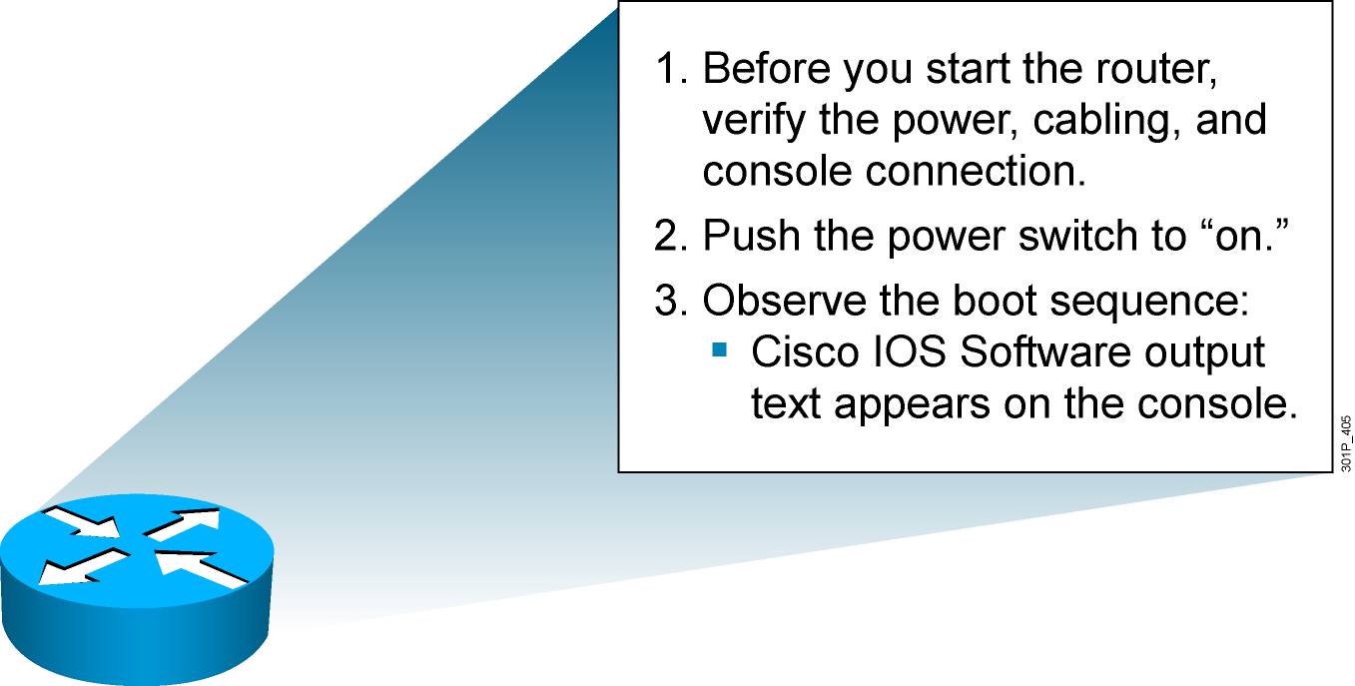
Initial Startup of the Cisco Router
  System startup routines initiate router software
  Router falls back to startup alternatives if needed
Notes:
Purpose: This slide describes a high-level overview of the startup sequences on the router.
Emphasize: A detailed flowchart covers this in much more detail in Chapter 6, “Catalyst Switch Operations.” Config register is also covered in Chapter 6.
The startup routines for Cisco IOS software have the goal of starting router operations. The router must deliver reliable performance connecting the user networks it was configured to serve. To do this, the startup routines must:
Make sure that the router comes up with tested hardware.
Find and load the Cisco IOS software that the router uses for its operating system.
Find and apply the configuration statements about router-specific attributes, protocol functions, and interface addresses.
The router will make sure that it comes up with tested hardware. When a Cisco router powers up, it performs a POST. These diagnostics verify the basic operation of the CPU, memory, and interface circuitry. After verifying the hardware functions, the router proceeds with software initialization. Some startup routines act as fallback operations that are able to perform the router startup should other routines be unable to do so. This flexibility allows Cisco IOS software to start up in a variety of initial situations.

Slide 3
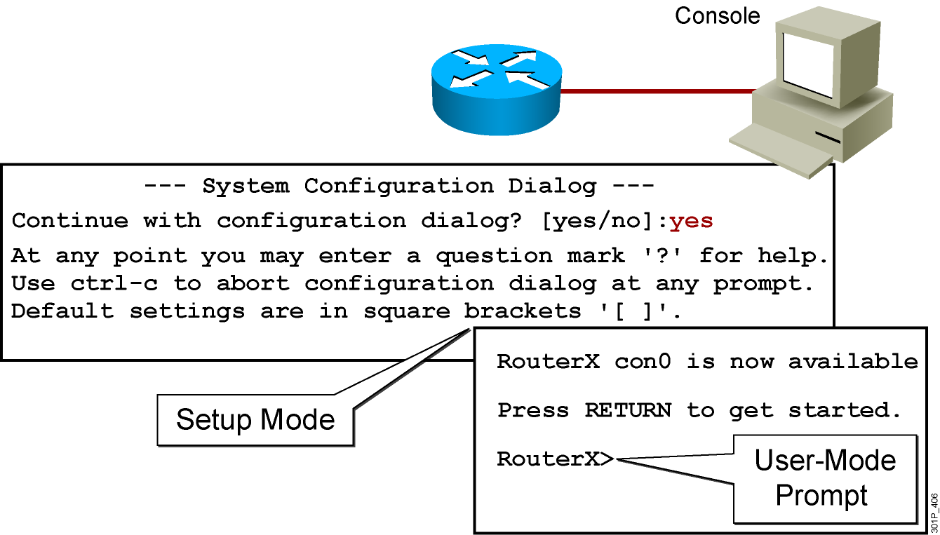
Bootup Output from the Router
Unconfigured vs. Configured Router
Notes:
Purpose: This slide describes the difference between the console output of an unconfigured router and a configured router.
Emphasize: The router has setup mode to prompt the user for an initial configuration. The Catalyst 1900 switch has no setup mode, it comes with a factory default configuration.
Transition: The next series of slides shows the setup mode prompting.
Note: The setup mode prompting on Cisco IOS Release 12.0 is different than pre-release 12.0.

Slide 4
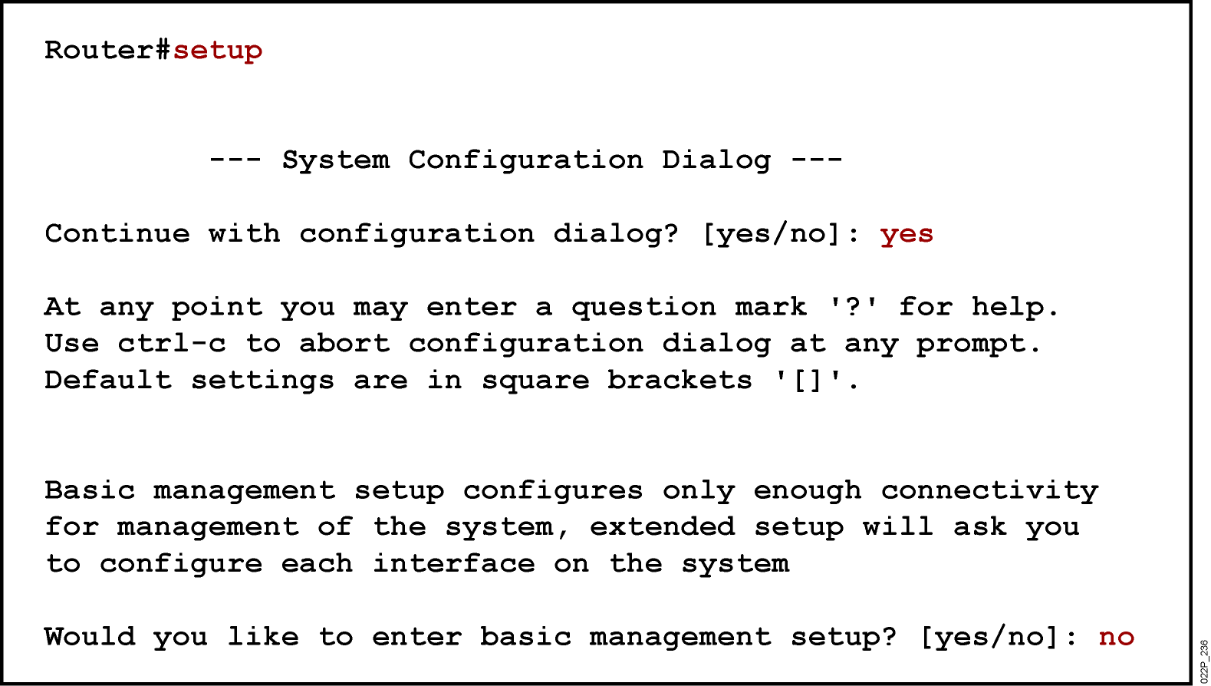
Setup: The Initial Configuration Dialog
Notes:
Purpose: This slide describes the setup mode on the router.
Emphasize: One routine for initial configuration is the setup mode. The primary purpose of the setup mode is to rapidly bring up a minimal-feature configuration for any router that cannot find its configuration from some other source.
For many of the prompts in the system configuration dialog of the setup command facility, default answers appear in square brackets ([ ]) following the question. Pressing the Return key allows you to use the defaults. If the system was previously configured, the defaults that appear are the currently configured values. If you are configuring the system for the first time, the factory defaults are provided. If there is no factory default, as in the case of passwords, nothing is displayed after the question mark (?).
At this point, you can choose not to continue with the system configuration dialog and exit by entering No at the prompt. To begin the initial configuration process, enter Yes. You can press Ctrl-C to terminate the process and start over at any time. When you are using the command form of setup (Router#setup), Ctrl-C returns you to the privileged EXEC prompt (Router#).
If a “-- More --” prompt appears, press the space bar to continue.
Note: When the student performs the router setup mode lab later, make sure they select “no” at the “Would you like to enter basic management setup?” prompt.

Slide 5
Setup Interface Summary
Any interface listed with OK? value "NO" does not have a valid configuration
Interface IP-Address OK? Method Status Protocol
FastEthernet0/0 unassigned NO unset up up
FastEthernet0/1 unassigned NO unset up up
Serial0/0/0 unassigned NO unset up up
Serial0/0/1 unassigned NO unset down down
  Interfaces Found During Startup
Notes:
Purpose: This slide describes the setup mode on the router.

Slide 6
Setup Initial Global Parameters
Configuring global parameters:
Enter host name [Router]:RouterX
  The enable secret is a password used to protect access to privileged EC and configuration modes. This password, after entered, becomes encrypted in the configuration.
Enter enable secret: Cisco1
  The enable password is used when you do not specify an enable secret password, with some older software versions, and some boot images.
Enter enable password: SanFran3
  The virtual terminal password is used to protect access to the router over a network interface.
Enter virtual terminal password: Sanj0se
Configure SNMP Network Management? [no]:
Notes:
Slide 1 of 2
Purpose: This slide describes the setup mode on the router.
Emphasize: You are prompted for global parameters at the console. You use the configuration values you have determined for your router to enter the global parameters at the prompts.
The first global parameter allows you to set the router host name. This host name will precede the Cisco IOS prompts for all configuration modes. At the factory the router name default is shown between the square brackets as [Router].
Use the next global parameters shown to set the various passwords used on the router.
You must enter an enable secret password. When you enter a string of password characters for the prompt to “Enter enable secret,” the characters are processed by Cisco-proprietary encryption, which can enhance the security of the password string. Whenever anyone lists the contents of the router configuration file, this enable password appears as a meaningless string of characters. Setup recommends, but does not require, that the enable password be different from the enable secret password.

Slide 7
Setup Initial Protocol Configurations
Configure IP? [yes]:
Configure RIP routing? [yes]: no
Configure CLNS? [no]:
Configure bridging? [no]:
Depending on your software revision this text may appear.
Notes:
Slide 2 of 2
Purpose: This slide describes the setup mode on the router.
Emphasize: When the students perform the lab later, make sure the students select “yes” to “Configure IP?” and “no” to all other protocols.

Slide 8
Setup Interface Parameters
Configuring interface parameters:
Do you want to configure FastEthernet0/0 interface? [yes]:
Use the 100 Base-TX (RJ-45) connector? [yes]:
Operate in full-duplex mode? [no]:
Configure IP on this interface? [yes]:
IP address for this interface: 10.2.2.11
Subnet mask for this interface [255.0.0.0] : 255.255.255.0
Class A network is 10.0.0.0, 24 subnet bits; mask is /24
Do you want to configure FastEthernet0/1 interface? [yes]: no
Do you want to configure Serial0/0/0 interface? [yes]: no
Do you want to configure Serial0/0/1 interface? [yes]: no
Notes:
Purpose: This slide describes the setup mode on the router.
Emphasize: You are prompted for parameters for each installed interface. You use the configuration values you have determined for your interface to enter the interface parameters at the prompts. Later on in the lab, the students will only be configuring an IP address on E0 only.
Note: With 12.0, the subnet mask is actually entered in dotted decimal format.

Slide 9
Cisco AutoSecure
Would you like to go through AutoSecure configuration? [yes]: no
AutoSecure dialog can be started later using "auto secure" CLI
Depending on your software revision, this text may appear.

Slide 10
Setup Script Review and Use
The following configuration command script was created:
hostname RouterX
enable secret 5 $1$aNMG$kV3mxjlWDRGXmfwjEBNAf1
enable password cisco
line vty 0 4
password sanjose
no snmp-server
!
ip routing
no clns routing
no bridge 1
!
interface FastEthernet0/0
media-type 100BaseX
half-duplex
ip address 10.2.2.11 255.255.255.0
no mop enabled
!
interface FastEthernet0/1
shutdown
no ip address
!
interface Serial0/0/0
shutdown
no ip address
!
interface Serial0/0/1
shutdown
no ip address
dialer-list 1 protocol ip permit
!
end
[0] Go to the IOS command prompt without saving this config.
[1] Return back to the setup without saving this config.
[2] Save this configuration to nvram and exit.
Enter your selection [2]: 2
Notes:
Purpose: This slide describes the options available when exiting out of the setup mode on the router.
Emphasize: When you complete the configuration process, select [2] to save the configurations to NVRAM and make the configuration active in RAM.
If you select [0], the configuration is not saved to NVRAM or RAM.
Note: With 12.0, these are new options to select when exiting setup mode.

Slide 11
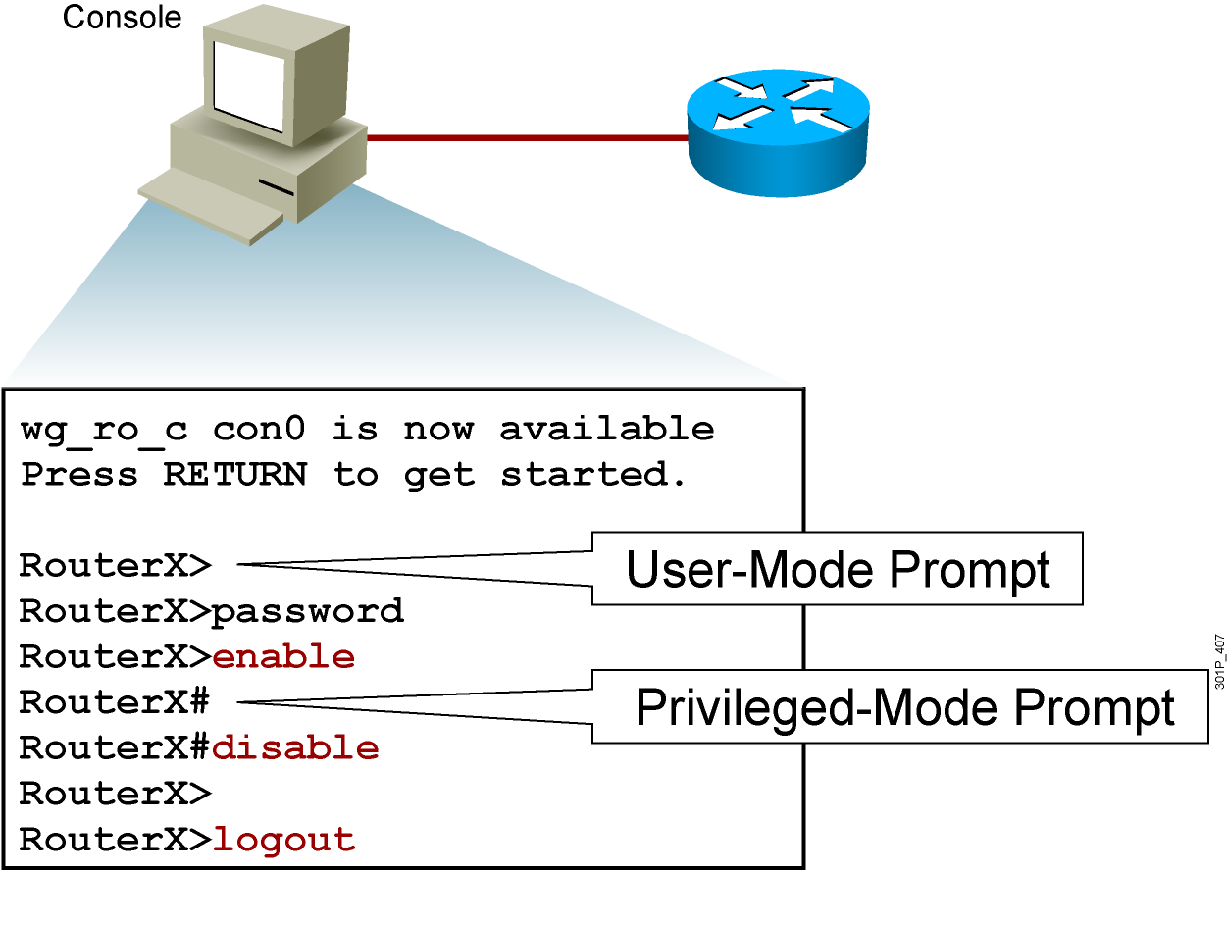
Logging in to the Cisco Router
Notes:
Purpose: This slide discusses the two EXEC modes.
Emphasize: Teach your students to look for and identify the prompt that indicates if they are in the correct mode for a given command.

Slide 12
Router User-Mode Command List
RouterX>?
Exec commands:
access-enable Create a temporary Access-List entry
access-profile Apply user-profile to interface
clear Reset functions
connect Open a terminal connection
disable Turn off privileged commands
disconnect Disconnect an existing network connection
enable Turn on privileged commands
exit Exit from the EXEC
help Description of the interactive help system
lat Open a lat connection
lock Lock the terminal
login Log in as a particular user
logout Exit from the EXEC
-- More --
You can abbreviate a command to the fewest characters that make a unique character string.
Notes:
Emphasize: Notice that there are more commands available on the router than the Catalyst 1900 switch.

Slide 13
Router Privileged-Mode Command List
RouterX#?
Exec commands:
access-enable Create a temporary Access-List entry
access-profile Apply user-profile to interface
access-template Create a temporary Access-List entry
bfe For manual emergency modes setting
cd Change current directory
clear Reset functions
clock Manage the system clock
configure Enter configuration mode
connect Open a terminal connection
copy Copy from one file to another
debug Debugging functions (see also 'undebug')
delete Delete a file
dir List files on a filesystem
disable Turn off privileged commands
disconnect Disconnect an existing network connection
enable Turn on privileged commands
erase Erase a filesystem
exit Exit from the EXEC
help Description of the interactive help system
-- More --
You can complete a command string by entering the unique character string, then pressing the Tab key.
Notes:
Emphasize: Notice that there are more commands available on the router than the Catalyst 1900 switch.

Slide 14
show version Command
Cisco IOS Software, 2800 Software (C2800NM-ADVIPSERVICESK9-M), Version 12.4(12), RELEASE SOFTWARE (fc1)
Technical Support: http://www.cisco.com/techsupport
Copyright (c) 1986-2006 by Cisco Systems, Inc.
Compiled Fri 17-Nov-06 12:02 by prod_rel_team
ROM: System Bootstrap, Version 12.4(13r)T, RELEASE SOFTWARE (fc1)
RouterX uptime is 2 days, 21 hours, 15 minutes
System returned to ROM by power-on
System image file is "flash:c2800nm-advipservicesk9-mz.124-12.bin"
This product contains cryptographic features and is subject to United States and local country laws governing import, export, transfer and use. Delivery of Cisco cryptographic products does not imply
third-party authority to import, export, distribute or use encryption. Importers, exporters, distributors and users are responsible for compliance with U.S. and local country laws. By using this product you agree to comply with applicable laws and regulations. If you are unable to comply with U.S. and local laws, return this product immediately.
A summary of U.S. laws governing Cisco cryptographic products may be found at:
http://www.cisco.com/wwl/export/crypto/tool/stqrg.html
If you require further assistance please contact us by sending email to
export@cisco.com.
Cisco 2811 (revision 53.50) with 249856K/12288K bytes of memory.
Processor board ID FTX1107A6BB
2 FastEthernet interfaces
2 Serial(sync/async) interfaces
1 Virtual Private Network (VPN) Module
DRAM configuration is 64 bits wide with parity enabled.
239K bytes of non-volatile configuration memory.
62720K bytes of ATA CompactFlash (Read/Write)
Configuration register is 0x2102
RouterX#
Notes:
Purpose: This slide presents the show version command.
Emphasize: Point out that this command is useful when troubleshooting problems because it gives the versions of the various software components and files. It also displays how long the router has been in operation and where it obtained the image file.
Config register is discussed in Chapter 6, “Catalyst Switch Operations.”

Slide 15
Summary
  The Cisco router startup sequence is similar to the startup sequence of the Cisco Catalyst switch. After performing POST, the router finds and loads the Cisco IOS image. Finally, it finds and loads the device configuration file.
  Use the enable command to access the privileged EXEC mode from the user EXEC mode.
  After logging in to a Cisco router, you can verify the initial startup status of a router by using the router status commands: show version, show running-config, and show
  startup-config

